Slide 1
DATA SCIENCE PROJECT
The below analysis contains data from a milk distributing company

Slide 2
Our dataset contains a total of 3,772 rows and 5 columns. The data is clean as it has no duplicates nor missing values.
SUMMARY OF THE DATASET

Slide 3
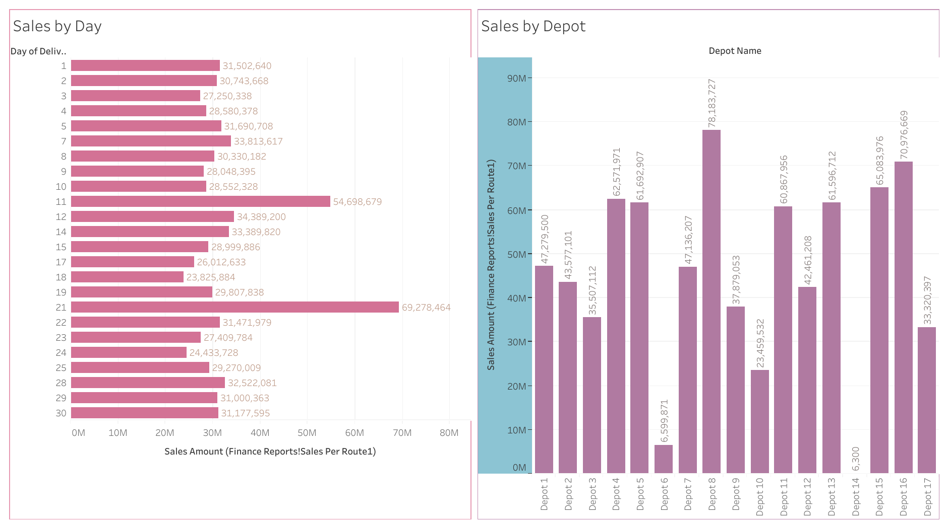
The photo below shows sales made on the month of January and also sales per each depot.

Slide 4
Summary of sales by each day and sales by each depot.
Sales by Day
Sales by Depot
From the analysis, we can see the sales are relatively average.
The lowest sale was on the 18th day with sale of kshs 23,825.,884M.
The highest sale was recorded on the 21st with a sale of kshs 69,278,464M.
As shown on the report above, sales per each depot differed maybe due to different factors.
Depot 14 recorded the lowest sale of kshs 6,300. This might have been caused by various factors.
Depot 8 recorded the highest sale of kshs 78,183,727M.

Slide 5
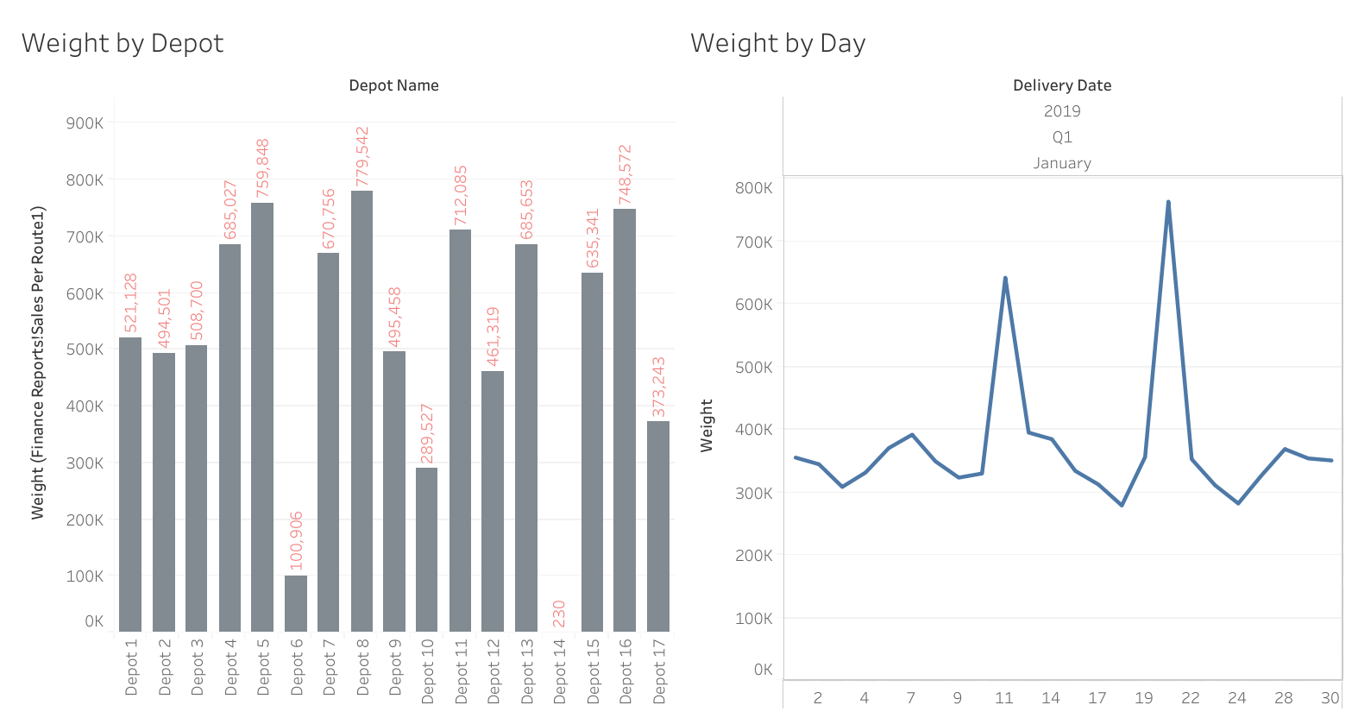
The photo below shows weight recorded per each depot and per each day.

Slide 6
Correlation
There is a strong correlation between the Weight variable and the Sales Amount variable This implies that the more the weight, the more the Sales Amount.

Slide 7
Summary of weight by each day and weight by each depot.
Weight by Depot
Weight by Day
From the analysis, we can observe there are depots that weight of milk was way too low unlike the rest of the depots.
The lowest weight was recorded by depot 14 which summed up to 230kgs.
The highest weight was recorded by depot 5 which accrued to 759,848kgs
As we can observe from the report above, weight recorded per each day had some variance.
The highest weight was recorded on the 21st day of January with a weight of 763,254kgs.
The lowest weight was observed on the 18th day with a weight of 279,099kgs.

Slide 8
Prediction using multiple linear regression
We can see that the value of root mean squared error is 38249.48.
This is more than 10% of the mean value of the Sales_Amount of 206309.702
10%_of_mean: 20327.222357615898
Clearly, this means that our algorithm is inaccurate and thus not ideal for prediction.

Slide 9
THE END

